Slide 1

Laboratory Work 2 Operational amplifiers circuits design and simulation
Nikolay Nikolaev (nanikolaev@itmo.ru)
Nikolai Poliakov (polyakov_n_a@itmo.ru)
Roman Olekhnovich (r.o.olekhnovich@mail.ru)
Notes:
Hello. We are starting our LAB2 «Operational amplifiers circuits design and simulation»

Slide 2
Summary
Operational amplifiers circuits theory review
Laboratory work 2: ideal and real amplifier comparison
Starting data analysis
Step 1: check of scheme gain
Step 2: check of scheme (time domain simulation)
Step 3: check of scheme (frequency domain simulation)
Results and conclusions
Uploading report

Slide 3
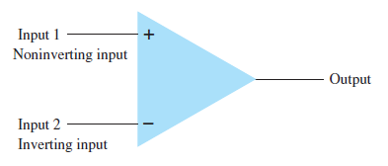
Single-Ended Input
Double-ended input, Single-Ended output
Double-Ended (Differential) Input
Common-Mode Operation

Slide 4
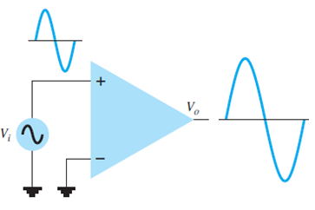
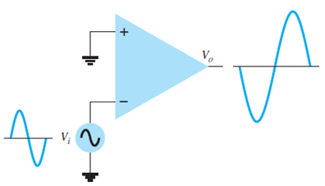
Single-Ended Input

Slide 5
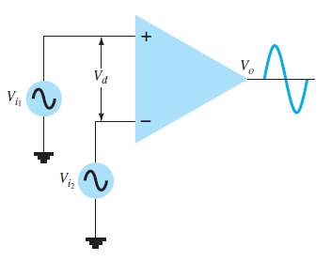
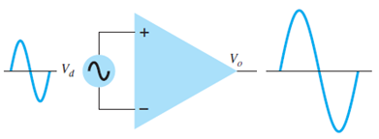
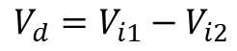
Double-Ended (Differential) Input
$$V_{d}=V_{i1}−V_{i2}$$
Notes:
Also it is possible to apply signals at each input—this being a double-ended operation. Left Figures on slide shows an input voltage, applied between the two input terminals (recall that neither input is at ground), with the resulting amplified output in phase with that applied between the plus and minus inputs. Left figure shows the same action resulting when two separate signals are applied to the inputs, with difference signal Vd.

Slide 6
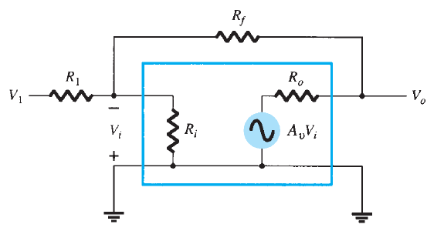
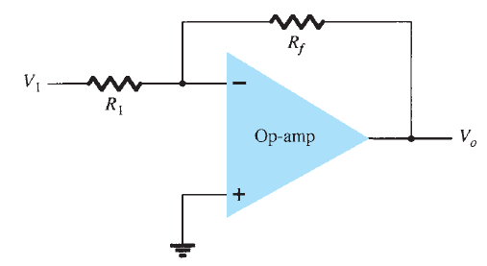
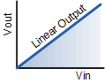
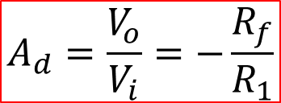
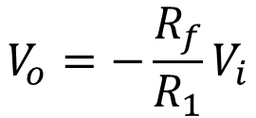
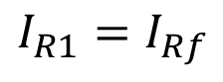
Inverting Amplifier
$$V_{o}=−\frac{R_{f}}{R_{1}}V_{i}$$
$$A_{d}=\frac{V_{o}}{V_{i}}=−\frac{R_{f}}{R_{1}}$$
$$I_{R1}=I_{Rf}$$

Slide 7
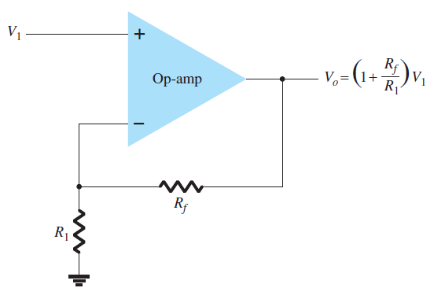
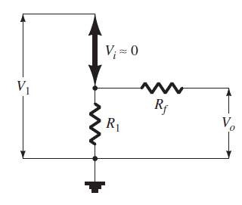
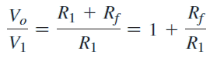
Noninverting Amplifier
Notes:
The connection on slide shows an op-amp circuit that works as a noninverting amplifier or constant-gain multiplier. It should be noted that the inverting amplifier connection is more widely used because it has better frequency stability.
In this configuration, the input voltage signal is applied directly to the non-inverting input terminal which means that the output gain of the amplifier becomes “Positive” in value in contrast to the “Inverting Amplifier” circuit we saw previously whose output gain is negative in value. The result of this is that the output signal is “in-phase” with the input signal.
Feedback control of the non-inverting operational amplifier is achieved by applying a small part of the output voltage signal back to the inverting ( – ) input terminal via a Rƒ – R2 voltage divider network, again producing negative feedback. This closed-loop configuration produces a non-inverting amplifier circuit with very good stability, a very high input impedance, Rin approaching infinity, as no current flows into the positive input terminal, (ideal conditions) and a low output impedance, Rout as shown below.
It can be shown that the gain of the circuit is…
It can be seen that the gain depends only on the feedback resistance and resistance 1 and does not depend on the intrinsic gain of the operational amplifier

Slide 8
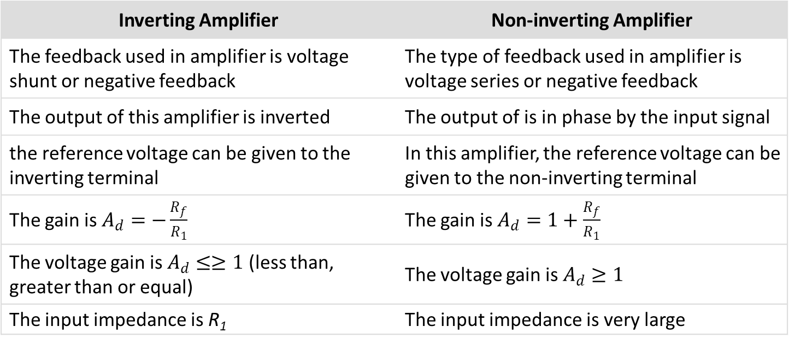
Comparison Inverting And Noninverting Amplifier
Inverting Amplifier | Non-inverting Amplifier
The feedback used in amplifier is voltage shunt or negative feedback | The type of feedback used in amplifier is voltage series or negative feedback
The output of this amplifier is inverted | The output of is in phase by the input signal
the reference voltage can be given to the inverting terminal | In this amplifier, the reference voltage can be given to the non-inverting terminal
The gain is $A_{d}=−\frac{R_{f}}{R_{1}}$ | The gain is $A_{d}=1+\frac{R_{f}}{R_{1}}$
The voltage gain is $A_{d}≤≥1$ (less than, greater than or equal) | The voltage gain is $A_{d}≥1$
The input impedance is R₁ | The input impedance is very large
Notes:
The main comparative characteristics of the inverting and non-inverting stages are presented in the table. The main differences between amplifiers are gain coefficient, phase shift between input and output, and input impedance of the circuit.

Slide 9
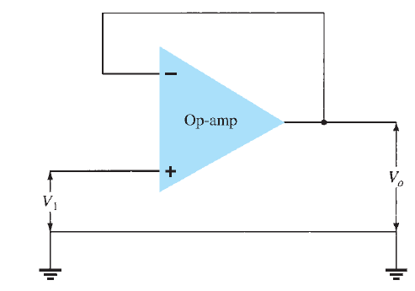
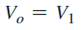
Unity Follower
Notes:
If we made the feedback resistor equal to zero and resistor 2 equal to infinity then the resulting circuit would have a fixed gain of “1” (unity) as all the output voltage is fed back to the inverting input terminal (negative feedback). This configuration would produce a special type of the non-inverting amplifier circuit called a Voltage Follower, also known as a “unity gain buffer”.
As the input signal is connected directly to the non-inverting input of the amplifier the output signal is not inverted resulting in the output voltage being equal to the input voltage. This then makes the voltage follower circuit ideal as a constant voltage source or voltage regulator because of its input to output isolation properties.
The advantage of the unity gain voltage follower configuration is that it can be used when impedance matching or circuit isolation is more important than voltage or current amplification as it maintains the input signal voltage at its output terminal. Also, the input impedance of the voltage follower circuit is extremely high, typically above 1MΩ as it is equal to that of the operational amplifiers input resistance times its gain. The op-amps output impedance is very low since an ideal op-amp condition is assumed so is unaffected by changes in load.

Slide 10
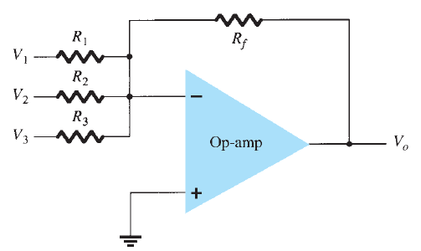
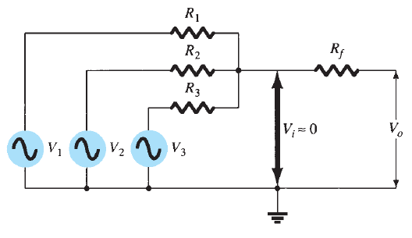
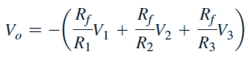
Summing Amplifier
Notes:
We saw previously in the inverting operational amplifier that the inverting amplifier has a single input voltage applied to the inverting input terminal. If we add more input resistors to the input, each equal in value to the original input resistor we end up with another operational amplifier circuit called a Summing Amplifier, “summing inverter” or even a “voltage adder” circuit as shown in figure.
In this simple summing amplifier circuit, the output voltage now becomes proportional to the sum of the input voltages. Then we can modify the original equation for the inverting amplifier to take account of these new inputs thus…
We now have an operational amplifier circuit that will amplify each individual input voltage and produce an output voltage signal that is proportional to the algebraic “SUM” of the three individual input voltages. We can also add more inputs if required as each individual input “sees” their respective input resistance as the only input impedance.
Note that when the summing point is connected to the inverting input of the op-amp the circuit will produce the negative sum of any number of input voltages. Likewise, when the summing point is connected to the non-inverting input of the op-amp, it will produce the positive sum of the input voltages.

Slide 11
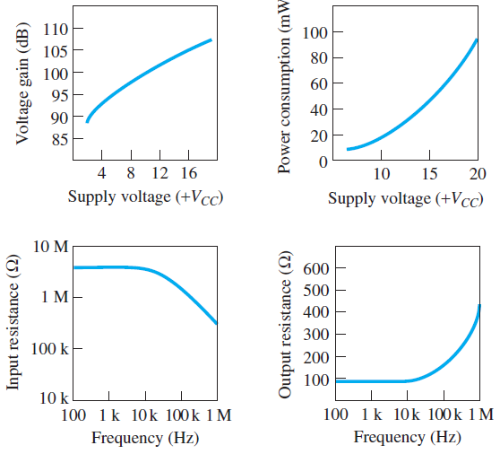
Op-Amp Performance
Notes:
The manufacturer provides a number of graphical descriptions to describe the performance of the op-amp. Slide includes some typical performance curves comparing various characteristics as a function of supply voltage. The open-loop voltage gain is seen to get larger with a larger supply voltage value. Whereas the previous tabular information provided information at a particular supply voltage, the performance curve shows how the voltage gain is affected by using a range of supply voltage values.
Another performance curve in Figure shows how power consumption varies as a function of supply voltage. As shown, the power consumption increases with larger values of supply voltage. For example, whereas the power dissipation is about 50 mW at power supply 15 V, it drops to about 5 mW with power supply 5 V. Two other curves show how the input and output resistances are affected by frequency: The input impedance drops and the output resistance increases at higher frequency.

Slide 12
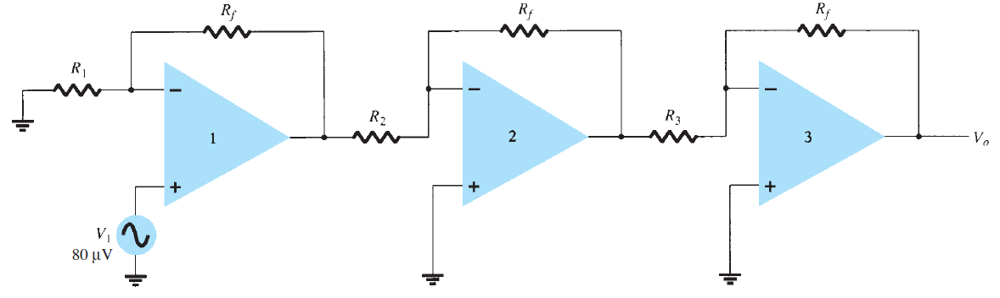
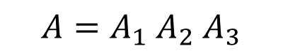
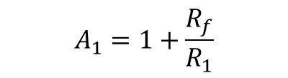


Multiple-Stage Gains
$$A_{1}=1+\frac{R_{f}}{R_{1}}$$
$$A_{2}=−\frac{R_{f}}{R_{2}}$$
$$A_{3}=−\frac{R_{f}}{R_{3}}$$
$A=A_{1}$ $A_{2}$ $A_{3}$
Notes:
When a number of stages are connected in series, the overall gain is the product of the individual stage gains. Figure on slide shows a connection of three stages. The first stage is connected to provide noninverting gain A1. The next two stages provide an inverting gain A2 and A3. The overall circuit gain is then noninverting and is calculated by equation…

Slide 13
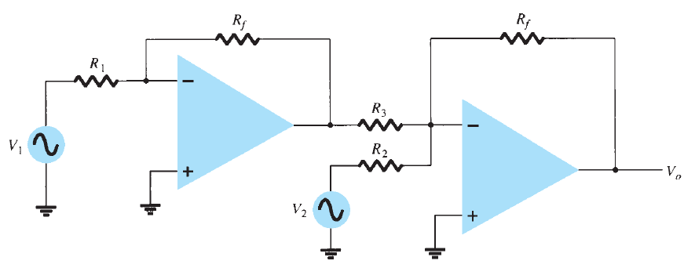
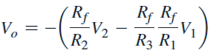
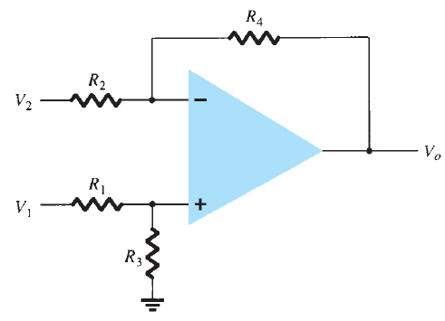
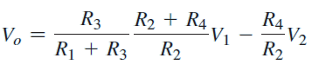
Voltage Subtractor
Notes:
Two signals can be subtracted from one another in a number of ways. Upper figure shows two op-amp stages used to provide subtraction of input signals.
The resulting output is given by that equation…
Another connection to provide subtraction of two signals is shown lower figure. This connection uses only one op-amp stage to provide subtracting two input signals. Using superposition, we can show the output to be
As you can see from the diagrams, the first option uses more operational amplifiers. While the second is only one. Moreover, in the first variant it is easier to obtain the necessary gain, and in the second it will be more difficult to select the appropriate resistances.

Slide 14
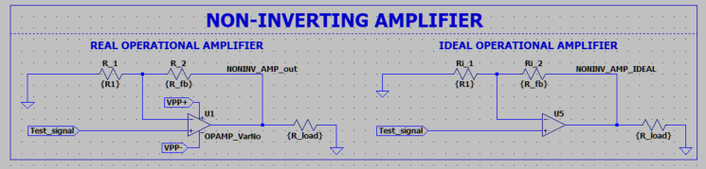
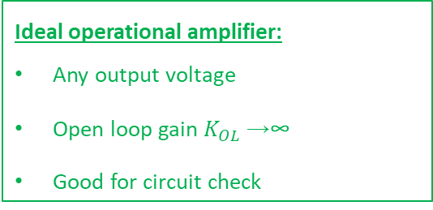
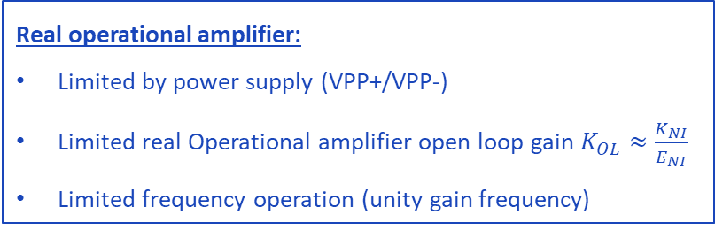
Laboratory work 2
EXAMPLE
Real operational amplifier:
Limited by power supply (VPP+/VPP-)
Limited real Operational amplifier open loop gain $K_{OL}≈\frac{K_{NI}}{E_{NI}}$
Limited frequency operation (unity gain frequency)
Ideal operational amplifier:
Any output voltage
Open loop gain $K_{OL}$→∞
Good for circuit check

Slide 15
Work purpose and goals
Work purpose: to study parameters of Operational Amplifier and basis of Operational amplifiers circuits design
Goals:
1) Design amplifier model on the basis of operational amplifier «Opamp_name»
2) Simulate amplifier scheme and analyze dependencies of output voltage from load and resistor values variation
3) Analyze time domain and frequency domain of amplifier
4) Simulate underpower state/power supply check

Slide 16
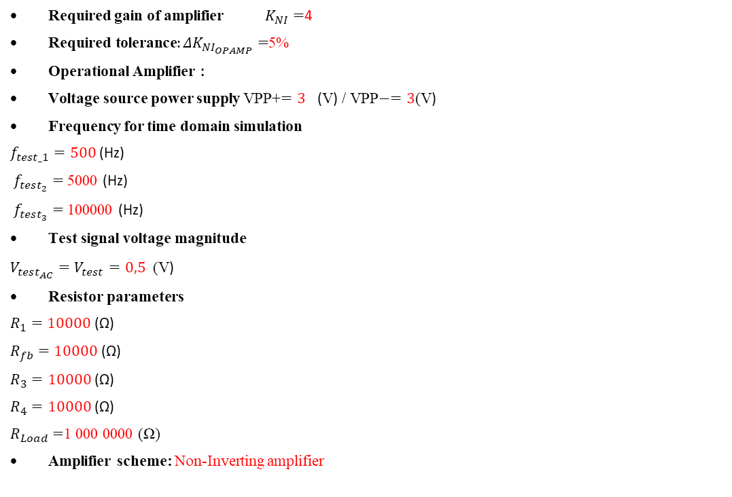
Starting data
Required gain of amplifier $K_{NI}=$4
$\text{Required} \text{tolerance}:{ΔK}_{NI_{OPAMP}}=$5%
Operational Amplifier :
Voltage source power supply VPP+$=3$ (V) / VPP$−=3$(V)
Frequency for time domain simulation
$f_{test_1}=500$ (Hz)
$f_{test_{2}}=$5000 (Hz)
$f_{test_{3}}=$100000 (Hz)
Test signal voltage magnitude
$V_{test_{AC}}=V_{test}=0,5$ (V)
Resistor parameters
$R_{1}=10000$ (Ω)
$R_{fb}=10000$ (Ω)
$R_{3}=10000$ (Ω)
$R_{4}=10000$ (Ω)
$R_{Load}=$1 000 0000 (Ω)
Amplifier scheme: Non-Inverting amplifier

Slide 17
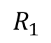
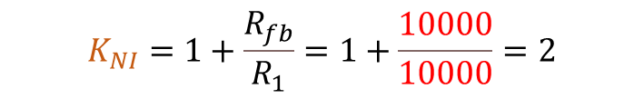
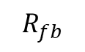
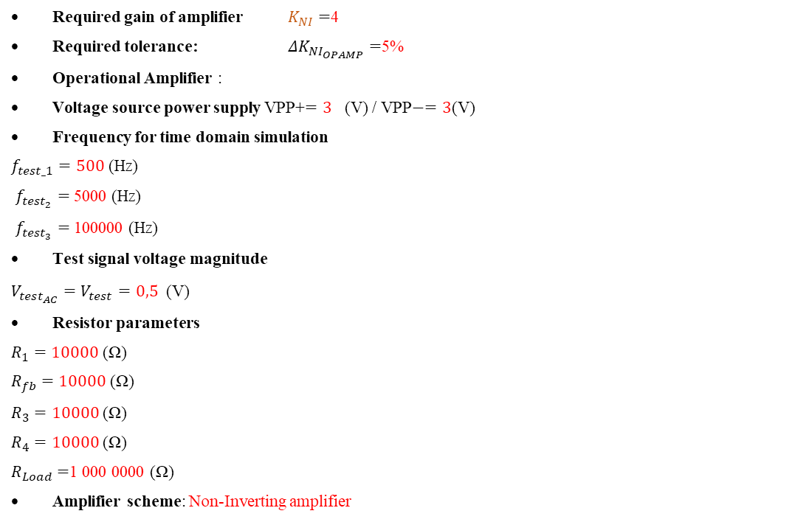
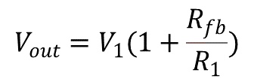
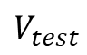
Step 1: check of scheme gain
Step 1: check of scheme gain
Required gain of amplifier $K_{NI}=$4
Required tolerance: ${ΔK}_{NI_{OPAMP}}=$5%
Operational Amplifier :
Voltage source power supply VPP+$=3$ (V) / VPP$−=3$(V)
Frequency for time domain simulation
$f_{test_1}=500$ (Hz)
$f_{test_{2}}=$5000 (Hz)
$f_{test_{3}}=$100000 (Hz)
Test signal voltage magnitude
$V_{test_{AC}}=V_{test}=0,5$ (V)
Resistor parameters
$R_{1}=10000$ (Ω)
$R_{fb}=10000$ (Ω)
$R_{3}=10000$ (Ω)
$R_{4}=10000$ (Ω)
$R_{Load}=$1 000 0000 (Ω)
Amplifier scheme: Non-Inverting amplifier
$$V_{test}$$
$${V_{out}=V}_{1}(1+\frac{R_{fb}}{R_{1}})$$
$$R_{1}$$
$$R_{fb}$$
$$K_{NI}=1+\frac{R_{fb}}{R_{1}}=1+\frac{10000}{10000}=2$$

Slide 18

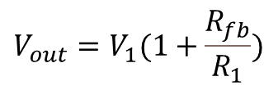
Step 1: check of scheme gain
Step 1: check of scheme gain
Required gain of amplifier $K_{NI}=$4
$\text{Required} \text{tolerance}$: ${ΔK}_{NI_{OPAMP}}=$5%
Operational Amplifier :
Voltage source power supply VPP+$=3$ (V) / VPP$−=3$(V)
Frequency for time domain simulation
$f_{test_1}=500$ (Hz)
$f_{test_{2}}=$5000 (Hz)
$f_{test_{3}}=$100000 (Hz)
Test signal voltage magnitude
$V_{test_{AC}}=V_{test}=0,5$ (V)
Resistor parameters
$R_{1}=10000$ (Ω)
$R_{fb}=10000$ (Ω)
$R_{3}=10000$ (Ω)
$R_{4}=10000$ (Ω)
$R_{Load}=$1 000 0000 (Ω)
Amplifier scheme: Non-Inverting amplifier
$$V_{test}$$
$${V_{out}=V}_{1}(1+\frac{R_{fb}}{R_{1}})$$
$$R_{1}$$
$$R_{fb}$$
$$K_{NI}=1+\frac{R_{fb}}{R_{1}}=1+\frac{10000}{10000}=2$$

Slide 19
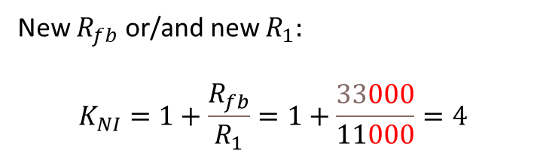
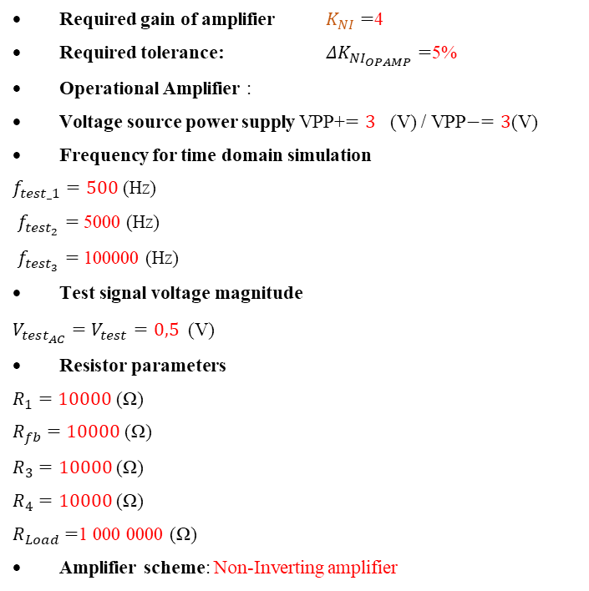
Step 1: check of scheme gain
Required gain of amplifier $K_{NI}=$4
Required tolerance: ${ΔK}_{NI_{OPAMP}}=$5%
Operational Amplifier :
Voltage source power supply VPP+$=3$ (V) / VPP$−=3$(V)
Frequency for time domain simulation
$f_{test_1}=500$ (Hz)
$f_{test_{2}}=$5000 (Hz)
$f_{test_{3}}=$100000 (Hz)
Test signal voltage magnitude
$V_{test_{AC}}=V_{test}=0,5$ (V)
Resistor parameters
$R_{1}=10000$ (Ω)
$R_{fb}=10000$ (Ω)
$R_{3}=10000$ (Ω)
$R_{4}=10000$ (Ω)
$R_{Load}=$1 000 0000 (Ω)
Amplifier scheme: Non-Inverting amplifier
Step 1: check of scheme gain
$$V_{test}$$
$${V_{out}=V}_{1}(1+\frac{R_{fb}}{R_{1}})$$
$$R_{1}$$
$$R_{fb}$$
New $R_{fb}$ or/and new $R_{1}:$
$$K_{NI}=1+\frac{R_{fb}}{R_{1}}=1+\frac{33000}{11000}=4$$

Slide 20
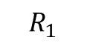

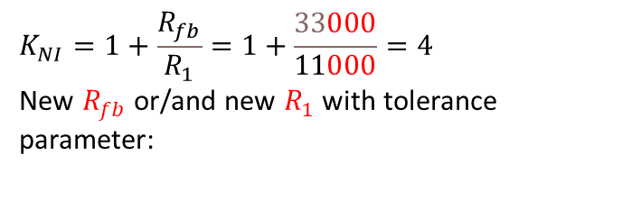
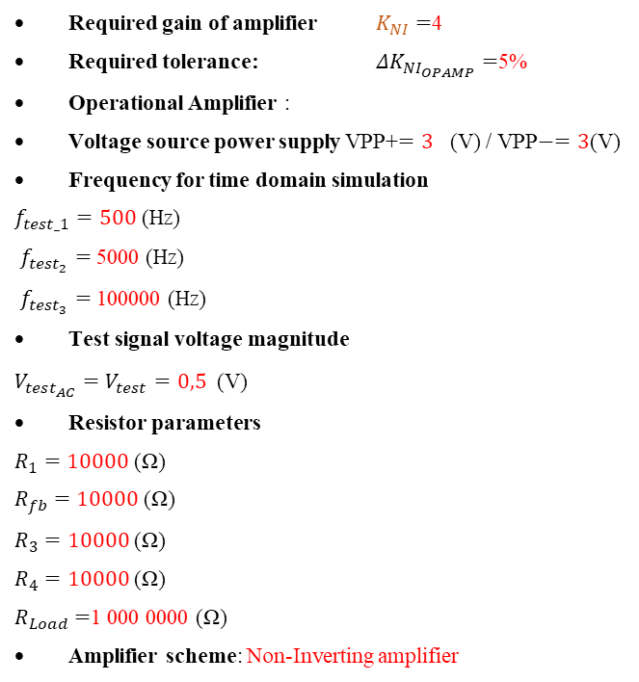
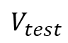
Step 1: check of scheme gain
Required gain of amplifier $K_{NI}=$4
Required tolerance: ${ΔK}_{NI_{OPAMP}}=$5%
Operational Amplifier :
Voltage source power supply VPP+$=3$ (V) / VPP$−=3$(V)
Frequency for time domain simulation
$f_{test_1}=500$ (Hz)
$f_{test_{2}}=$5000 (Hz)
$f_{test_{3}}=$100000 (Hz)
Test signal voltage magnitude
$V_{test_{AC}}=V_{test}=0,5$ (V)
Resistor parameters
$R_{1}=10000$ (Ω)
$R_{fb}=10000$ (Ω)
$R_{3}=10000$ (Ω)
$R_{4}=10000$ (Ω)
$R_{Load}=$1 000 0000 (Ω)
Amplifier scheme: Non-Inverting amplifier
$${V_{out}=V}_{1}(1+\frac{R_{fb}}{R_{1}})$$
$$V_{test}$$
$$R_{1}$$
$$R_{fb}$$
$$K_{NI}=1+\frac{R_{fb}}{R_{1}}=1+\frac{33000}{11000}=4$$
New $R_{fb}$ or/and new $R_{1}$ with tolerance parameter:

Slide 21
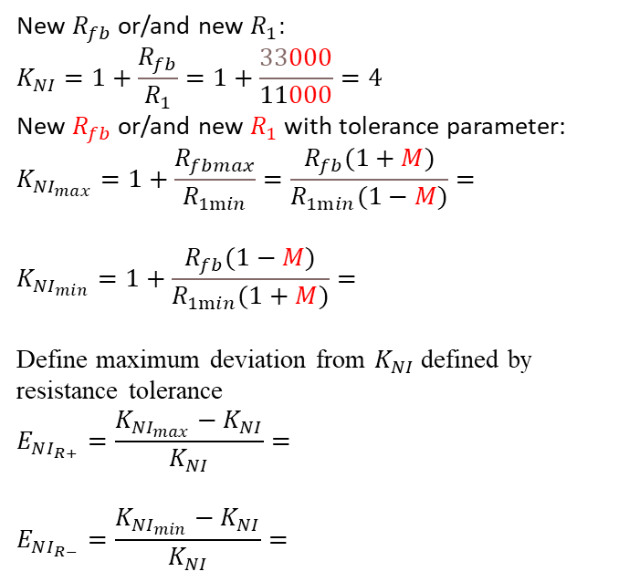
Step 1: check of scheme gain
New $R_{fb}$ or/and new $R_{1}:$
$$K_{NI}=1+\frac{R_{fb}}{R_{1}}=1+\frac{33000}{11000}=4$$
New $R_{fb}$ or/and new $R_{1}$ with tolerance parameter:
$$K_{{NI}_{max}}=1+\frac{R_{fbmax}}{R_{1min}}=\frac{R_{fb}(1+M)}{R_{1min}(1−M)}=$$
$$K_{{NI}_{min}}=1+\frac{R_{fb}(1−M)}{R_{1min}(1+M)}=$$
Define maximum deviation from $K_{NI}$ defined by resistance tolerance
$$E_{NI_{R+}}=\frac{K_{{NI}_{max}}−K_{NI}}{K_{NI}}=$$
$$E_{NI_{R−}}=\frac{K_{{NI}_{min}}−K_{NI}}{K_{NI}}=$$
Step 1: check of scheme gain
$$V_{test}$$
$${V_{out}=V}_{1}(1+\frac{R_{fb}}{R_{1}})$$
$$R_{1}$$
$$R_{fb}$$

Slide 22
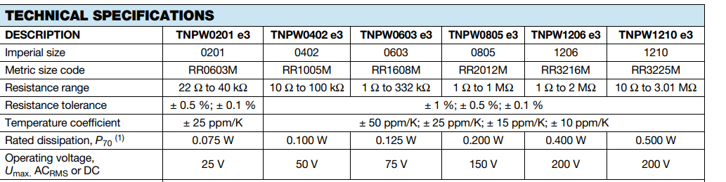
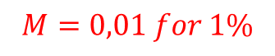
Step 1: check of scheme gain
New $R_{fb}$ or/and new $R_{1}:$
$$K_{NI}=1+\frac{R_{fb}}{R_{1}}=1+\frac{33000}{11000}=4$$
New $R_{fb}$ or/and new $R_{1}$ with tolerance parameter:
$$K_{{NI}_{max}}=1+\frac{R_{fbmax}}{R_{1min}}=\frac{R_{fb}(1+M)}{R_{1min}(1−M)}=$$
$$K_{{NI}_{min}}=1+\frac{R_{fb}(1−M)}{R_{1min}(1+M)}=$$
Define maximum deviation from $K_{NI}$ defined by resistance tolerance
$$E_{NI_{R+}}=\frac{K_{{NI}_{max}}−K_{NI}}{K_{NI}}=$$
$$E_{NI_{R−}}=\frac{K_{{NI}_{min}}−K_{NI}}{K_{NI}}=$$
Step 1: check of scheme gain
$$V_{test}$$
$${V_{out}=V}_{1}(1+\frac{R_{fb}}{R_{1}})$$
$$R_{1}$$
$$R_{fb}$$
$$M=0,01 for 1\%$$

Slide 23
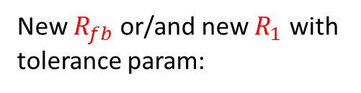



Starting data
Step 1: check of scheme gain
New $R_{fb}$ or/and new $R_{1}:$
$$K_{NI}=1+\frac{R_{fb}}{R_{1}}=1+\frac{33000}{11000}=4$$
New $R_{fb}$ or/and new $R_{1}$ with tolerance parameter:
$$K_{{NI}_{max}}=1+\frac{R_{fbmax}}{R_{1min}}=\frac{R_{fb}(1+M)}{R_{1min}(1−M)}=$$
$$K_{{NI}_{min}}=1+\frac{R_{fbmin}}{R_{1max}}=1+\frac{R_{fb}(1−M)}{R_{1min}(1+M)}=$$
Define maximum deviation from $K_{NI}$ defined by resistance tolerance
$$E_{NI_{R+}}=\left|\frac{K_{{NI}_{max}}−K_{NI}}{K_{NI}}\right|=$$
$$E_{NI_{R−}}=\left|\frac{K_{{NI}_{min}}−K_{NI}}{K_{NI}}\right|=$$
New $R_{fb}$ or/and new $R_{1}$ with tolerance param:
$$K_{NI}=1+\frac{R_{fb}}{R_{1}}=1+\frac{33000}{11000}=4$$
$$M=0,01 for 1\%$$

Slide 24



Starting data
Required gain of amplifier $K_{NI}=$4
Required tolerance: ${ΔK}_{NI_{OPAMP}}=$5%
Operational Amplifier :
Voltage source power supply VPP+$=3$ (V) / VPP$−=3$(V)
Frequency for time domain simulation
$f_{test_1}=500$ (Hz)
$f_{test_{2}}=$5000 (Hz)
$f_{test_{3}}=$100000 (Hz)
Test signal voltage magnitude
$V_{test_{AC}}=V_{test}=0,5$ (V)
Resistor parameters
$R_{1}=10000$ (Ω)
$R_{fb}=10000$ (Ω)
$R_{3}=10000$ (Ω)
$R_{4}=10000$ (Ω)
$R_{Load}=$1 000 0000 (Ω)
Amplifier scheme: Non-Inverting amplifier
$$K_{{NI}_{max}}=1+\frac{R_{fbmax}}{R_{1min}}=\frac{R_{fb}(1+M)}{R_{1min}(1−M)}=$$
$$K_{{NI}_{min}}=1+\frac{R_{fb}(1−M)}{R_{1min}(1+M)}=$$
Define maximum deviation from $K_{NI}$ defined by resistance tolerance
$E_{NI_{R+}}=\left|\frac{K_{{NI}_{max}}−K_{NI}}{K_{NI}}\right|=$ (should be less then 5%)
$E_{NI_{R−}}=\left|\frac{K_{{NI}_{min}}−K_{NI}}{K_{NI}}\right|=$ (should be less then 5%)
${ΔK}_{NI_{OPAMP}}=$ max of $E_{NI_{R+}}$ and $E_{NI_{R−}}$

Slide 25


Starting data
Step 1: check of scheme gain
$$K_{{NI}_{max}}=1+\frac{R_{fbmax}}{R_{1min}}=$$
$K_{{NI}_{min}}=1+\frac{R_{fbmin}}{R_{1max}}=$
Define maximum deviation from $K_{NI}$ defined by resistance tolerance
$$E_{NI_{R+}}=\left|\frac{K_{{NI}_{max}}−K_{NI}}{K_{NI}}\right|=\text{(}\text{should} \text{be} \text{less} \text{then}\text{ 5\%)}$$
$$E_{NI_{R−}}= \left|\frac{K_{{NI}_{min}}−K_{NI}}{K_{NI}}\right|=\text{(}\text{should} \text{be} \text{less} \text{then}\text{ 5\%)}$$
New $R_{fb}$ or/and new $R_{1}$ with tolerance param:
$$K_{NI}=1+\frac{R_{fb}}{R_{1}}=1+\frac{33000}{11000}=4$$
$\text{Required} \text{tolerance} :{ΔK}_{NI_{OPAMP}}=$5%
Real Operational amplifier open loop gain $K_{OL}≈\frac{K_{NI}}{E_{NI}}$

Slide 26

Simulations: time domain simulation
Step 2: check of scheme (time domain simulation)
Setting up resistor tolerance:
Providing simulations:
$f_{test_1}=500$ (Hz)
$f_{test_{2}}=$5000 (Hz)
$f_{test_{3}}=$100000 (Hz)

Slide 27

Simulations: frequency domain simulation
Step 3: check of scheme (frequency domain simulation)
setting up resistor tolerance $R_{fb}$ and new $R_{1}$
setting up resistor load resistance variation 𝑹_{𝒍𝒐𝒂𝒅} 𝒍𝒊𝒔𝒕: 100, 1000, 10000, 100000 (Ω)

Slide 28
Simulations
Step 4: Power supply check
Vpp+ and Vpp- should have enough values

Slide 29

Simulation results
 | Ideal | VarNo | Ideal | VarNo | Ideal | VarNo
frequency, kHz | 500,000 |  | 5000 |  | 50000
V_{test}, V
V_{out}, V
K_{NI_exp}
$${ΔK}_{NI_{OPAMP}}$$
$$E_{NI_{max}}$$
$$E_{NI_{min}}$$
$$K_{OL}≈\frac{K_{NI}}{{ΔK}_{NI_{OPAMP}}}$$
Real Operational amplifier open loop gain $K_{OL}≈\frac{K_{NI}}{E_{NI}}$

Slide 30

Conclusions
Conclusions should contain:
1) Is it possible to realize amplifier with defined gain and gain tolerance?
2) In which range can be load resistance $R_{Load}$ variated
3) How was operational amplifier power supply modified?

Slide 31

Lab 2 submission form
https://forms.yandex.com/cloud/636daa90d046881001fdbbf1/
https://clck.ru/32eHHL
1st deadline: 23.11.2022 23:59 (GMT +8)

Slide 32


